Slide 1

6th Grade Math
Unit 10, Lesson 6 Outliers Volume 2, pg. 225

Slide 2


Benchmark
MA.6.DP.1.6
Given a real-world scenario, determine and describe how changes in data values impact measures of center and variation.
volume 2, pg. 225

Slide 3
Integrated Mathematical Thinking and Reasoning Standards
MA.K12.MTR.4.1 Engage in discussions that reflect on the mathematical thinking of self and others.
MA.K12.MTR.5.1 Use patterns and structure to help understand and connect mathematical concepts.
MA.K12.MTR.7.1 Apply mathematics to real-world contexts.
volume 2, pg. 225

Slide 4

Learning Targets
I can determine how data is impacted by an outlier.
I can relate the impact of an outlier to which measures of center and variation best describe a distribution.
volume 2, pg. 225

Slide 5

Warm-Up
volume 2, pg. 226

Slide 6
10.6.1 Warm-Up: You Tell the Story
Robbie goes into a restaurant and orders a deli sandwich and a cola for lunch. Afterward, he pays the bill, tips his waitress, and goes outside. He slowly takes in his surroundings. The sky is black and the city streets are deserted. What happened?
volume 2, pg. 226

Slide 7

Exploration
volume 2, pg. 226

Slide 8

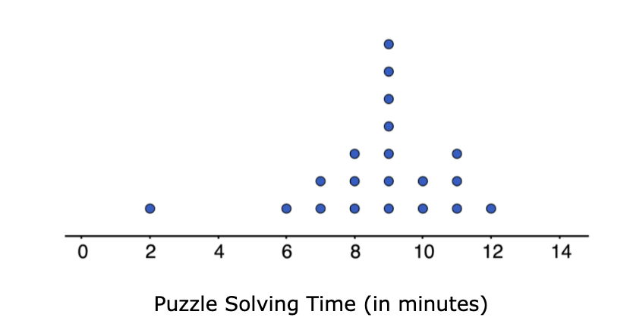
10.6.2 Exploration: Data Values
Work with your partner to complete the following.
Twenty students timed how long it took each of them to solve a puzzle. Below is a list of their solution times, in minutes, and a dot plot displaying the data.
2, 6, 7, 7, 8, 8, 8, 9, 9, 9, 9, 9 ,9, 9, 10, 10, 11, 11, 11, 12
volume 2, pg. 226

Slide 9
Describe the distribution of data.
Determine the mean of the data set. Then, draw an arrow (↑) below the number line that points to this value.
Determine the median of the data set. Then, circle the value on the number line that represents this value.
Discuss with your partner what you notice about the mean and the median of the data. Summarize your discussion.
What is the range of the data?
volume 2, pg. 226

Slide 10
Find the interquartile range (IQR).
Q1 | Q3 | IQR
Imagine that the fastest time of 2 minutes was removed from the data set. Discuss with your partner what effect, if any, removing this value has on the values of center and variation (mean, median, range, IQR). Summarize your discussion.
How does the shape of the graph change after 2 is removed?
volume 2, pg. 227

Slide 11
4. Compare the new values with the original values.
 | Original Value | >, <, = | New Value after 2 is Removed
Mean
Median
Range
IQR
volume 2, pg. 227

Slide 12

Bring It Together
volume 2, pg. 228

Slide 13

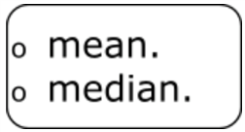
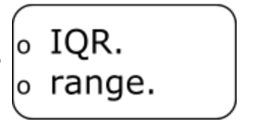
10.6.3 Bring It Together: Outlier Effects
Complete each statement to describe the effect the outlier, 2, has on each measure of center or variation.
The presence of an outlier does not have a significant effect on the
The presence of an outlier will change, often significantly, the value of the
The presence of an outlier does not have a significant effect on the
volume 2, pg. 228

Slide 14

The presence of an outlier will change, often significantly, the value of the
When outliers are present or a distribution is skewed, the ____________ is the preferred measure of center and the _________ is the preferred measure of variation to describe the distribution.
volume 2, pg. 228

Slide 15

Guided Practice
volume 2, pg. 228

Slide 16

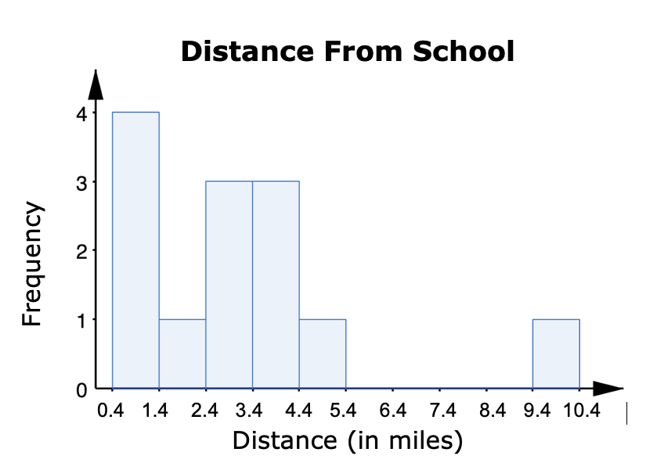
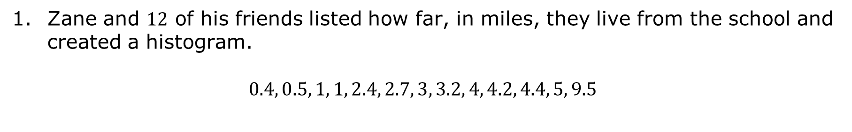
10.6.4 Guided Practice: Data Outliers
Zane and $12$ of his friends listed how far, in miles, they live from the school and created a histogram.
$0.4, 0.5, 1, 1, 2.4, 2.7, 3, 3.2, 4, 4.2, 4.4, 5, 9.5$
volume 2, pg. 228

Slide 17
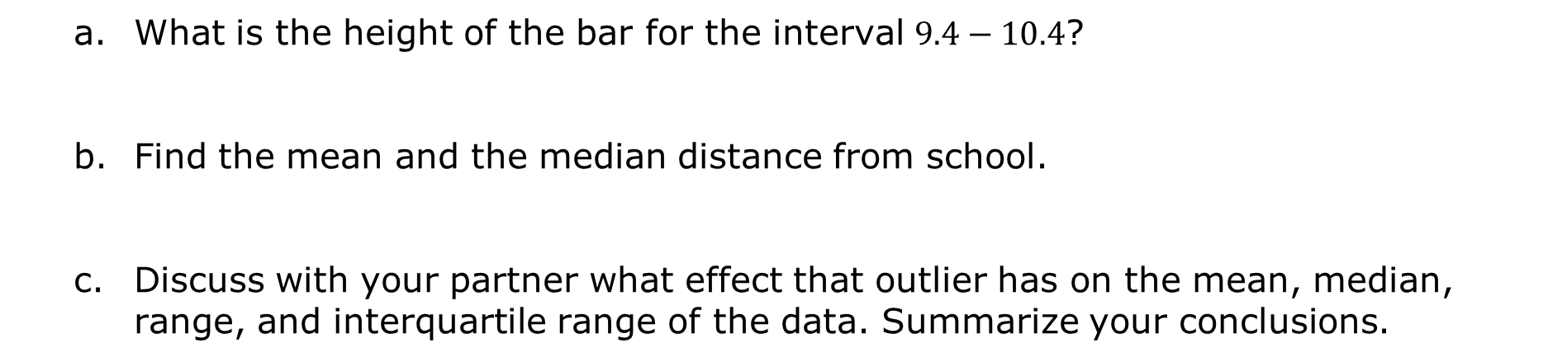
What is the height of the bar for the interval $9.4−10.4$?
Find the mean and the median distance from school.
Discuss with your partner what effect that outlier has on the mean, median, range, and interquartile range of the data. Summarize your conclusions.
volume 2, pg. 228

Slide 18
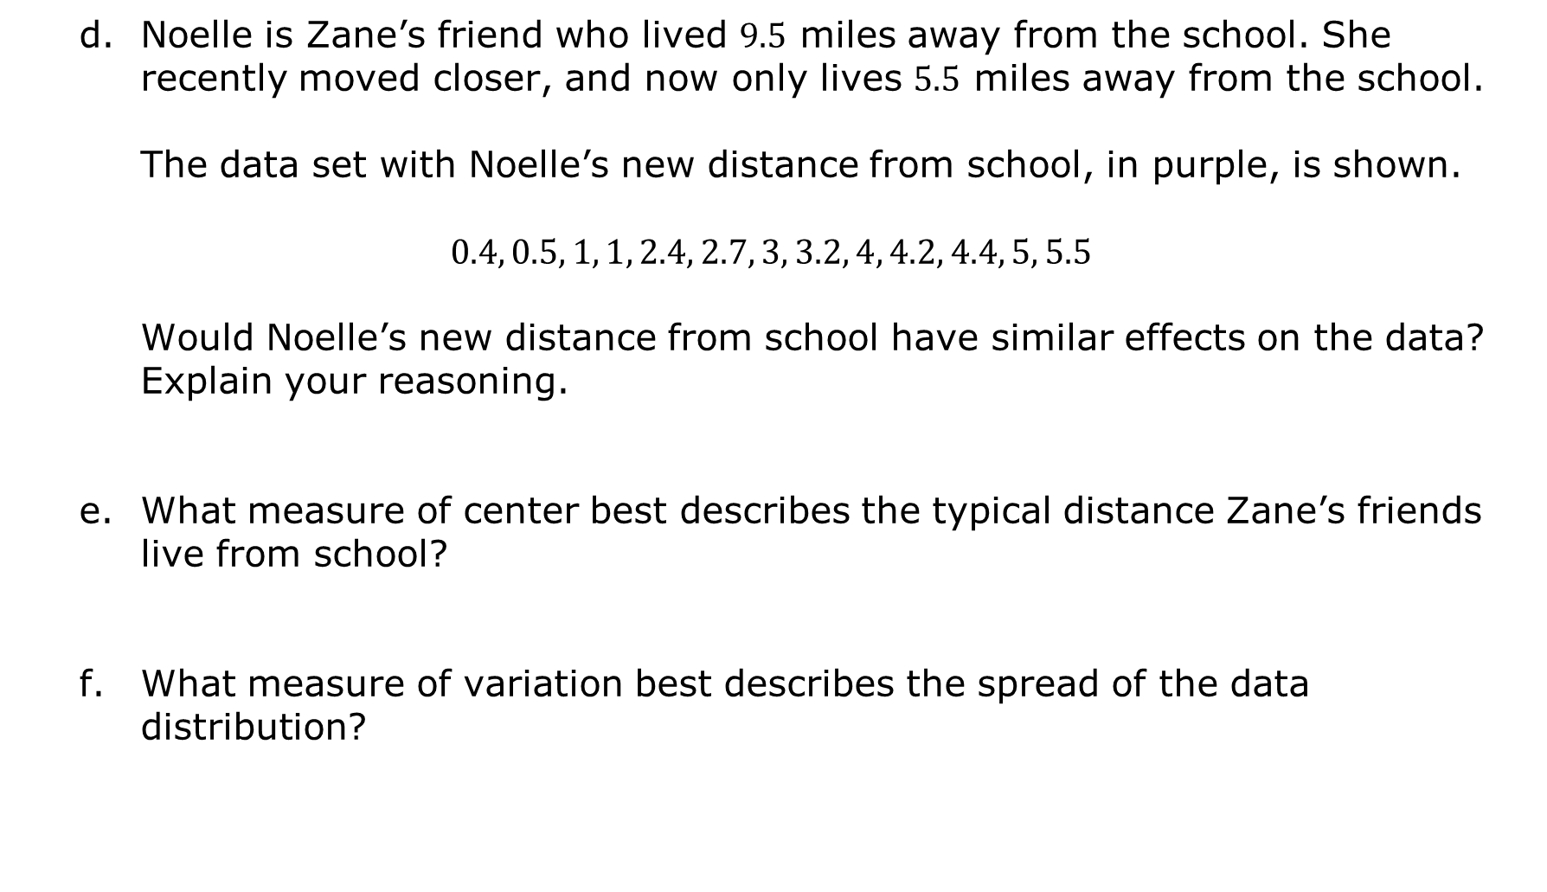
Noelle is Zane’s friend who lived $9.5$ miles away from the school. She recently moved closer, and now only lives $5.5$ miles away from the school.
The data set with Noelle’s new distance from school, in purple, is shown.
$$0.4, 0.5, 1, 1, 2.4, 2.7, 3, 3.2, 4, 4.2, 4.4, 5, 5.5$$
Would Noelle’s new distance from school have similar effects on the data? Explain your reasoning.
What measure of center best describes the typical distance Zane’s friends live from school?
What measure of variation best describes the spread of the data distribution?
volume 2, pg. 229

Slide 19

Your Turn
volume 2, pg. 229

Slide 20
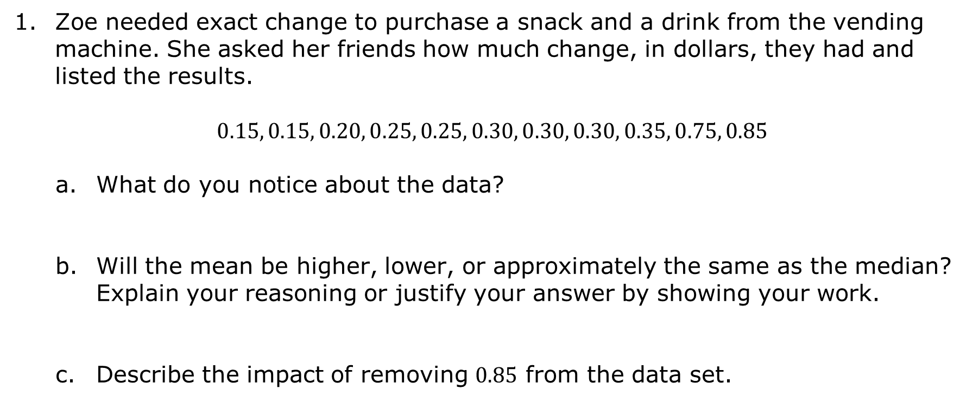
10.6.5 Your Turn!
Zoe needed exact change to purchase a snack and a drink from the vending machine. She asked her friends how much change, in dollars, they had and listed the results.
$$0.15, 0.15, 0.20, 0.25, 0.25, 0.30, 0.30, 0.30, 0.35, 0.75, 0.85$$
What do you notice about the data?
Will the mean be higher, lower, or approximately the same as the median? Explain your reasoning or justify your answer by showing your work.
Describe the impact of removing $0.85$ from the data set.
volume 2, pg. 229

Slide 21
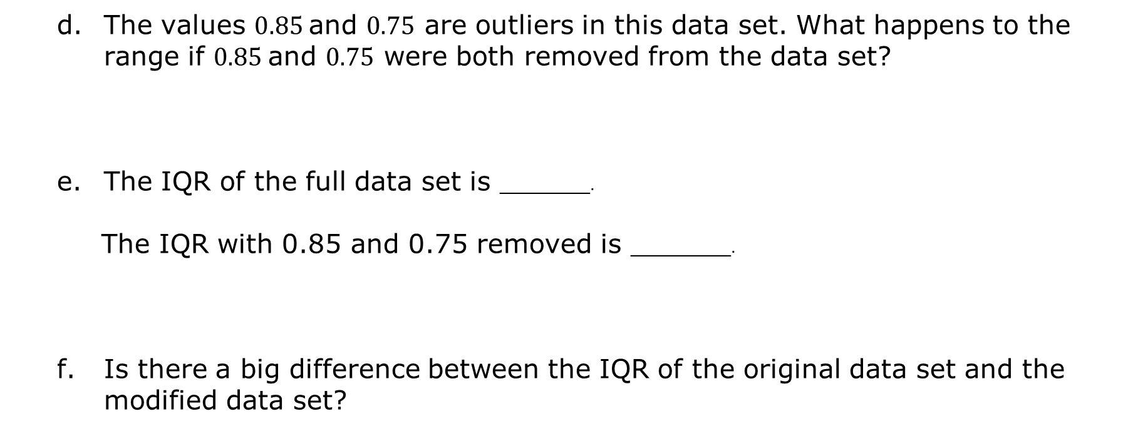
$$0.15, 0.15, 0.20, 0.25, 0.25, 0.30, 0.30, 0.30, 0.35, 0.75, 0.85$$
The values $0.85$and $0.75$ are outliers in this data set. What happens to the range if $0.85$and $0.75$ were both removed from the data set?
The IQR of the full data set is _________.
The IQR with 0.85 and 0.75 removed is __________.
Is there a big difference between the IQR of the original data set and the modified data set?
volume 2, pg. 230

Slide 22

Wrap-Up
volume 2, pg. 230

Slide 23
10.6.6 Wrap-Up: Cool Down
The presence of an outlier has a significant effect on which measures of center and spread? Select all that apply.
Mean
Median
Interquartile Range
Range
A data set has an outlier that is significantly less than most of the other values.
Explain how this impacts the measures selected in number 1.
Which measures of center and variation would you use to best describe the data?
volume 2, pg. 230

